Slide 1
Quick Notes: Pointer

Slide 2


Slide 3

Declaration of Pointer

Slide 4
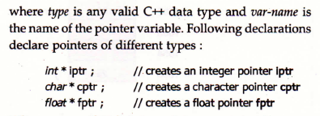
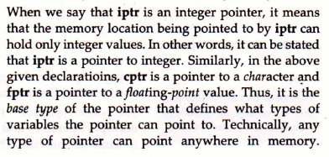

Slide 5
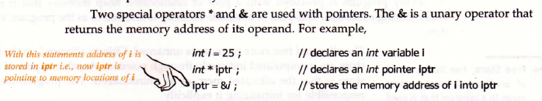
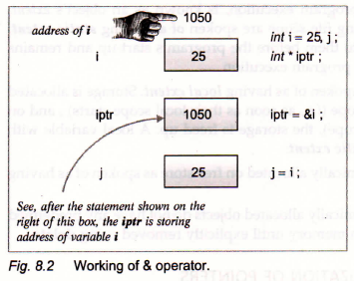
Working with Pointer

Slide 6
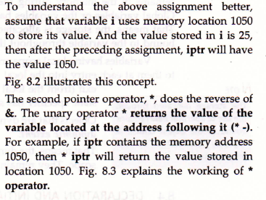

Slide 7
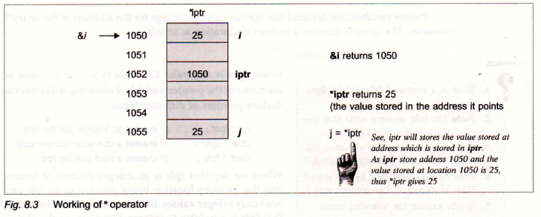
*p = value at address p

Slide 8



Slide 9
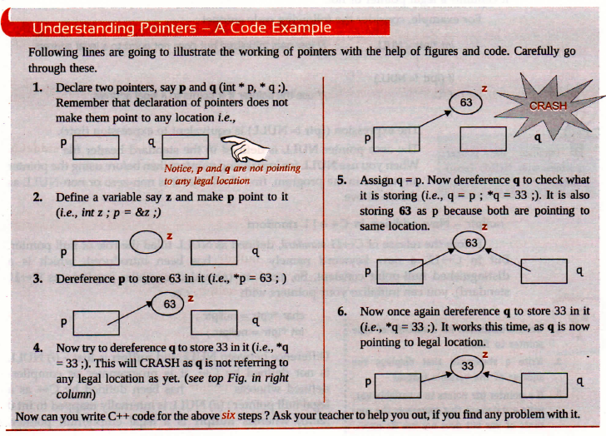
*p = value at address &z *q = valu at address of z

